Slide 1
Analyzing Sales Funnel for a Student Hostel Accomodation Chain
D1: Process Map for the Funnel
The goal of this milestone is for you to complete the following tasks to proceed further:
Analyze the sales funnel to identify the essential stages involved in the student journey, from lead generation to final onboarding and create a visual process map that visually represents the various stages of the sales funnel.
Based on the identified stages, prepare a comprehensive funnel report as provided in the Deliverables tab. Utilize charts, graphs, or tables to effectively present the funnel.
Ashish Kumar
Ashishkumar.hh2000@gmail.com

Slide 2
Process View
pre verified
Verified
Visited
Agreement
connected
onboarded
This stage represents the initial phase of the funnel, where leads are in the process of being verified for eligibility and suitability.
After the pre-verification stage, leads move to the verified stage, indicating that they have met the necessary criteria and have been confirmed as qualified prospects.
In this stage, the verified leads have progressed further and have visited the designated location or platform for further engagement and interaction.
Once the leads have visited and expressed interest, the agreement stage is reached, where negotiations and discussions take place to establish mutual terms and conditions.
After reaching an agreement, the leads move to the connected stage, where the necessary connections and arrangements are made to facilitate the intended purpose or service.
The final stage of the funnel is the onboarding stage, where the leads are officially welcomed and integrated into the system, becoming active participants or users of the offered service.
Ashishkumar.hh2000@gmail.com

Slide 3
Sales Funnel Overview
OVERALL FUNNEL STAGES
 | pre verified | Verifed | Visited | Agreement | connected | onboarded | Total
Delhi | 698 | 366 | 321 | 232 | 160 | 44 | 1821
Noida | 165 | 91 | 74 | 28 | 39 | 2 | 399
Bangalore | 449 | 240 | 220 | 158 | 101 | 27 | 1195
Gurugram | 683 | 361 | 280 | 174 | 145 | 30 | 1673
Mumbai | 276 | 147 | 126 | 90 | 63 | 16 | 718
Pune | 332 | 164 | 114 | 59 | 71 | 12 | 752
Hyderabad | 210 | 123 | 117 | 76 | 51 | 11 | 588
Ahmedabad | 107 | 54 | 31 | 13 | 24 | 7 | 236
Chandigarh | 52 | 25 | 17 | 8 | 12 | 0 | 114
Kolkata | 153 | 88 | 63 | 47 | 34 | 10 | 395
Blank | 359 | 198 | 155 | 84 | 83 | 9 | 888
 | 3484 | 1857 | 1518 | 969 | 783 | 168 | 8779

Slide 4
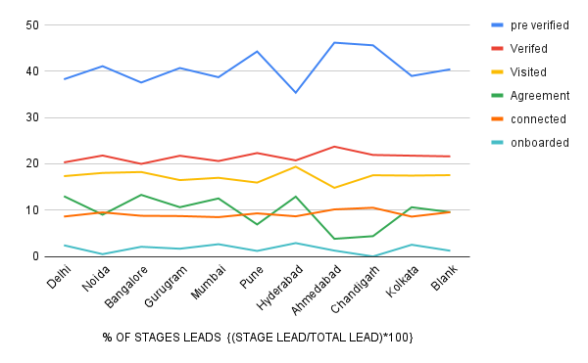
Sales Funnel Stages (Line Chart)
Ashishkumar.hh2000@gmail.com

Slide 5
THANK YOU!
Ashishkumar.hh2000@gmail.com

